Slide 1
Lab 8:
Robot Arm II
4/27
Jacky

Slide 2
What is MoveIt?
MoveIt! is state of the art software for mobile manipulation, incorporating the latest advances in motion planning, manipulation, 3D perception, kinematics, control and navigation.

Slide 3
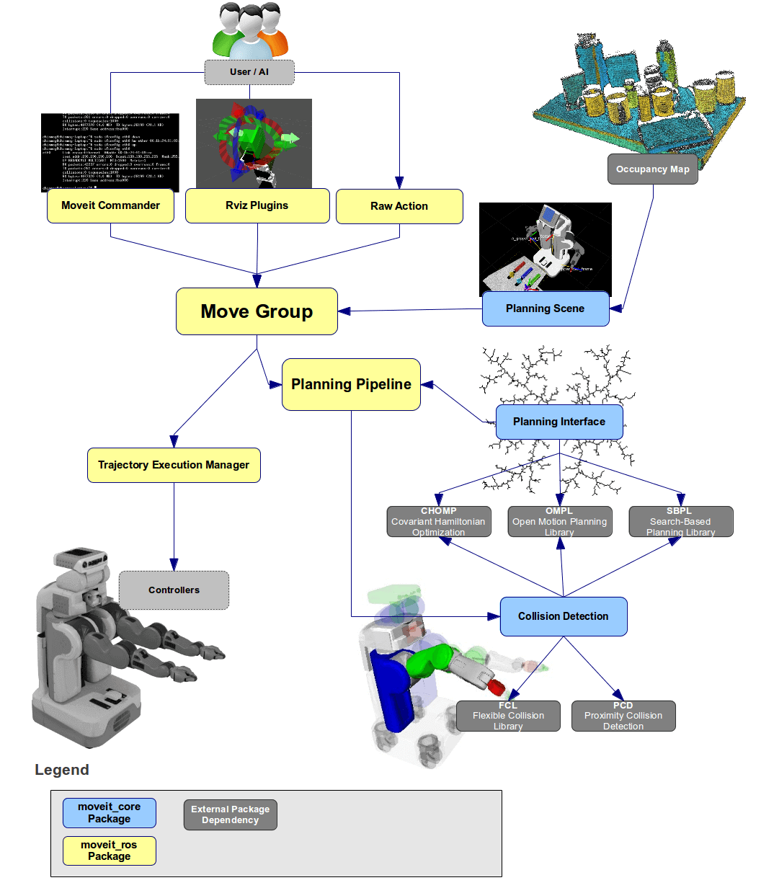
Concepts
System Architecture
1. Quick High Level Diagram

Slide 4
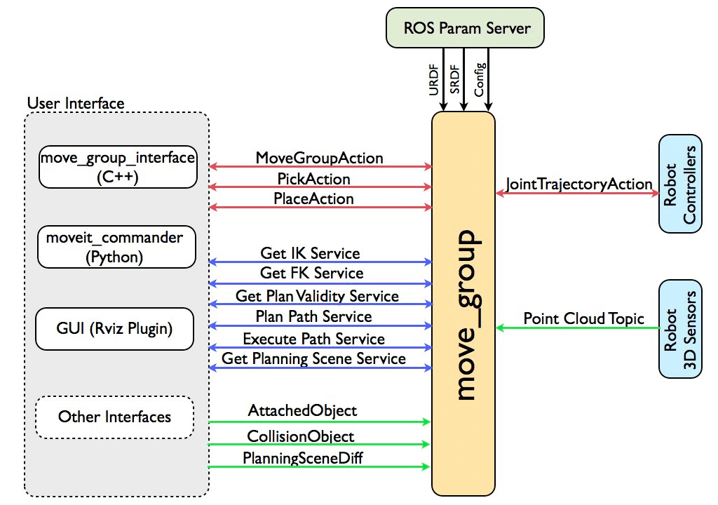
Concepts
System Architecture
2. The move_group node

Slide 5
Concepts
System Architecture
3. User Interface
The users can access the actions and services provided by move_group in one of three ways:
In C++ - using the move_group_interface package that provides an easy to setup C++ interface to move_group
In Python - using the moveit_commander package
Through a GUI - using the Motion Planning plugin to Rviz (the ROS visualizer)

Slide 6
Concepts
System Architecture
4. Configuration
move_group is a ROS node. It uses the ROS param server to get three kinds of information:
URDF - move_group looks for the robot_description parameter on the ROS param server to get the URDF for the robot.
SRDF - move_group looks for the robot_description_semantic parameter on the ROS param server to get the SRDF for the robot. The SRDF is typically created (once) by a user using the MoveIt Setup Assistant.
MoveIt configuration - move_group will look on the ROS param server for other configuration specific to MoveIt including joint limits, kinematics, motion planning, perception and other information. Config files for these components are automatically generated by the MoveIt setup assistant and stored in the config directory of the corresponding MoveIt config package for the robot.

Slide 7
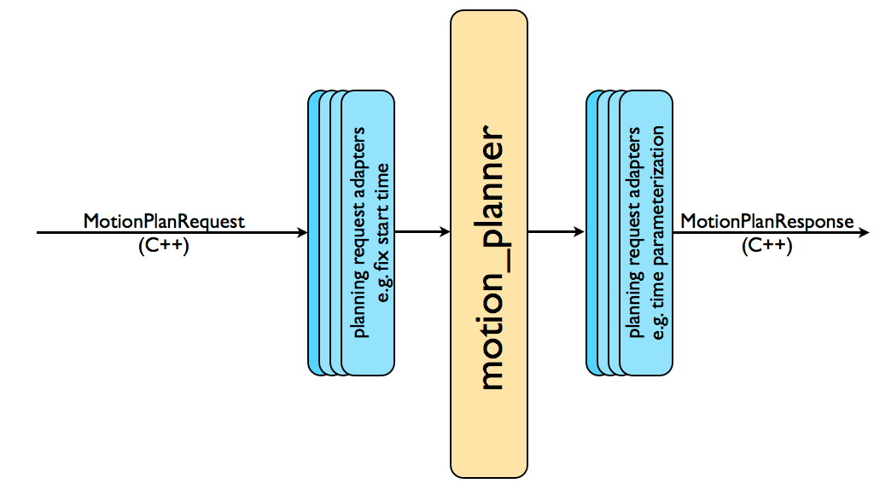
Concepts
Motion Planning
The Motion Plan Request
Position constraints
Orientation constraints
Visibility constraints
Joint constraints
User-specified constraints
The Motion Plan Result
The movegroup node will generate a desired trajectory in response to your motion plan request.

Slide 8
Concepts
OMPL (Open Motion Planning Library)
OMPL is an open-source motion planning library that primarily implements randomized motion planners. MoveIt integrates directly with OMPL and uses the motion planners from that library as its primary/default set of planners.

Slide 9
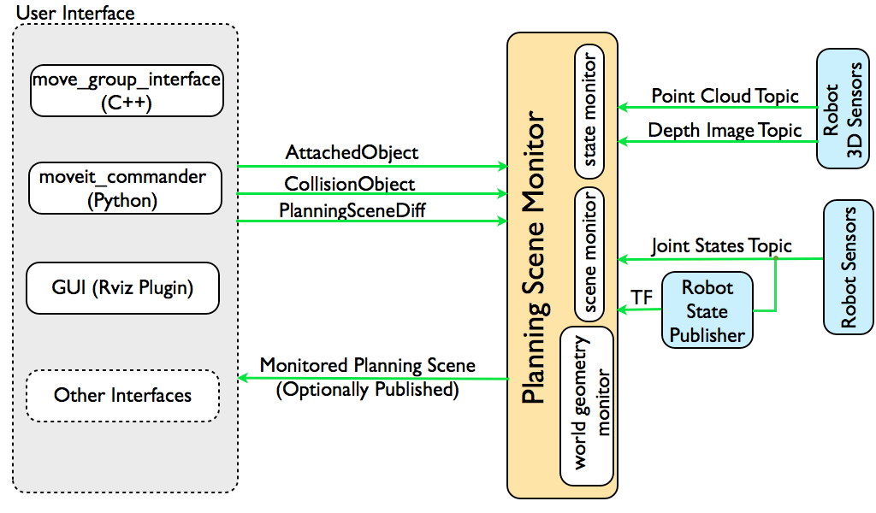
Concepts
Planning Scene
The planning scene is used to represent the world around the robot and also stores the state of the robot itself.
State Information: on the joint_states topic
Sensor Information: using the world geometry monitor described below
World geometry information: from user input on the planning_scene topic (as a planning scene diff)

Slide 10
Concepts
Kinematics
The Kinematics Plugin
MoveIt uses a plugin infrastructure, especially targeted towards allowing users to write their own inverse kinematics algorithms. Forward kinematics and finding jacobians is integrated within the RobotState class itself. The default inverse kinematics plugin for MoveIt is configured using the KDL numerical jacobian-based solver. This plugin is automatically configured by the MoveIt Setup Assistant.
IKFast Plugin
Often, users may choose to implement their own kinematics solvers, e.g. the PR2 has its own kinematics solvers. A popular approach to implementing such a solver is using the IKFast package to generate the C++ code needed to work with your particular robot.

Slide 11
Concepts
Collision Checking
Collision checking in MoveIt is configured inside a Planning Scene using the CollisionWorld object and is mainly carried out using the FCL package - MoveIt’s primary CC library.
Collision Objects
MoveIt supports collision checking for different types of objects including:
Meshes
Primitive Shapes - e.g. boxes, cylinders, cones, spheres and planes

Slide 12
Concepts
Trajectory Processing
Time parameterization
Motion planners will typically only generate “paths”, i.e. there is no timing information associated with the paths. MoveIt includes a trajectory processing routine that can work on these paths and generate trajectories that are properly time-parameterized accounting for the maximum velocity and acceleration limits imposed on individual joints. These limits are read from a special joint_limits.yaml file that is specified for each robot.

